Slide 1
Forms of Market
UNIT-5

Slide 2
In economics, market doesn’t refers to any physical place, particular shape or super market.
In economics, market refers to the whole region where buyers & seller are in contact with each other, offer to effect the demand and supply of commomdity.
Types of market
1. perfect Competition
2 Monopoly Competition
3.Monopolistic Competition
4. Oligopoly Market.

Slide 3
Perfect Competition
It refers to a market condition, where there are large no. of buyer & seller, and the product is homogeneous at a price fixed by the market.
Features of the market.
Homogeneous product
Free entry and exit
Identical price

Slide 4
4. Perfect knowledge
5. No advertisement cost
6. Price taker
7 . Demand curve = elasticity is infinite(ꚙ)
If the price changes the there will be huge change in demand.
8. Market of photocopy
9. Large no. of buyer and seller

Slide 5
Monopoly market
Only one seller selling his product with no close substitute and strong barrier to entry.
Ex – Railway in India
Features :-
One seller and large no. of buyer
No close substitute of the product
restriction in entry
price maker firm

Slide 6
Demand curve ( e<1)
whatever may be the change in price but no major change in quantity.

Slide 7
Monopolistic market
This is the market which is combination of perfect competition and monopoly market
It refers to the market in which there are a large numbers of sellers selling closely related differentiated products to a large no. of buyers.
Features:-

Slide 8
1 . Large no of buyers and sellers
2. Product differentiation
3. Freedom of entry and exit of firms
4. selling cost – To advertise
5. Lack of perfect knowledge
6. Non- price Competiton
7. Demand curve = ( elasticity >1)
If price changes then there will be more changes in demand.

Slide 9
Oligopoly market
Oligopoly is a market situation in which an industry has only a few firms mutually dependent for taking decision about price and output.
Features :-
Oligopoly means few sellers are selling differentiated products.
Interdepedence

Slide 10
3. Selling cost
4. Barriers of entry
5. Formation of cartel
6.Non – price competiton
7. Nature of product
a. Homogenous product
b. Heterogeneous product

Slide 11
Types of oligopoly market
Collusive Oligopoly
If the firm cooperate with each other , in determining the price or output or both , it is called Collusive Oligopoly.
Non- Collusive Oligopoly
I f in an oligopoly market, the firms compete with each other, it is called non- collusive oligopoly

Slide 12
Market Equlibrium
It is defined as a situation when there is equality between the quantity demanded and quantity supplied .
Quantity Demanded = Quantity Supplied.

Slide 13
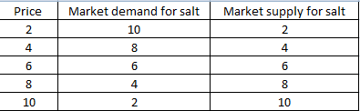
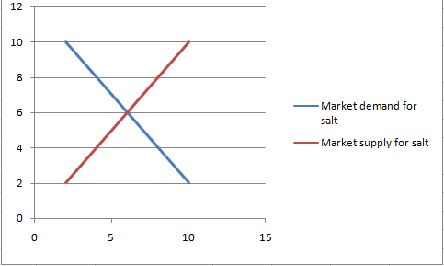
E = equilibrium price

Slide 14
E = Equlibrium price = 6
At point E , Quantity demanded = quuantity suplied.
Q.1The market demand and supply schedule of X commodity are given below:

Slide 15

Determine :
The equilibrium price and equilibrium quantity.
Excess demand at rs 2 per Kg.
Excess supply at rs 15 per kg.

Slide 16
(ii) Excess demand at rs 2 per Kg = 18 – 5 =13 Kg.
(iii)Excess Supply at rs 15 per Kg = 20 – 4 = 16 Kg.
Q.2 suppose the demand and supply curve of salt are given by :
Qd = 1000- P
Qs = 700 + 2P
(i) Find the equilibrium price and equilibrium qty.

Slide 17
(ii) Now suppose that the price of an input used to produce salt increases so that the new supply curve is Qs = 400 + 2P
How does the Eq. price And quantity Change.
(iii) Suppose the govt. has imposed a tax of Rs 3 per unit of sale. How does it affect the equilibrium price & quantity.

Slide 18
Ans . 1. At eq price.
1000-p = 700 + 2P
P = Rs 100
2.1000-p = 400 +2p ------ p = 200
Qs = qd = 800
3. Qs = 700 + 2(p-3) = 700 +2P-6= 694 + 2P
Now for equilibrium
Qd= Qs
1000-P = 694 + 2P
P=Rs102
New eq. qty. Qs = 694 +2P = 694 +2*102= Rs 898
eq. qty. Qd = 1000-P = 1000-102 = Rs 898
Eq. Price = Rs 102

